Slide 1

KHANS

Slide 2
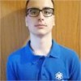
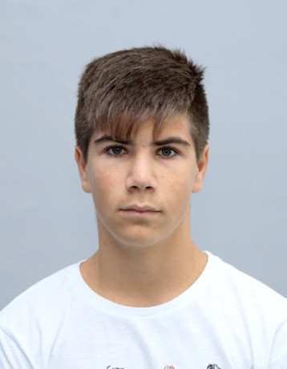

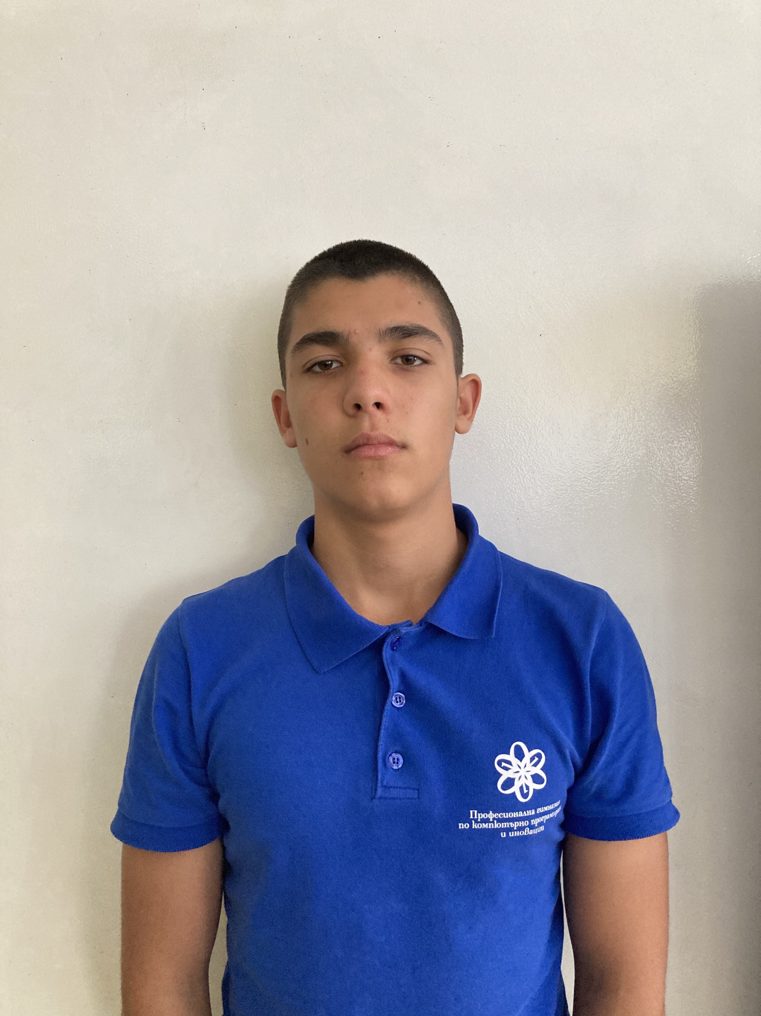
Members
Dimitar Bodurov (Scrum Trainer) DTBodurov19@codingburgas.bg
Ivan Ivanov (Front-end Developer) IAIvanov19@codingburgas.bg
Radoslav Ivanov (Back-end Developer) RGIvanov19@codingburgas.bg
Ioan Dimitrov (Q&A) IGDimitrov19@codingburgas.bg

Slide 3





Used programs

Slide 4
Stages of realization

Slide 5

Project preview

Slide 6

Thank you for your attention

